Slide 1

ONLINE RECIPE WEBSITE
PREPARED BY: ELIZABETH AKINSANMI (CST20HND0275)
SUPERVISED BY: Mr. LAWAL REMI LUKMAN

Slide 2
Table of Content
1
Background of the Study
2
Statement of the Problem
3
Aims and Objective of the Study
5
Summary of Literature Review
6
Research Methodology
4
Significance of the Study
7
System Modeling
8
Proposed Interface Design
9
Summary / Conclusion
Presentation Title

Slide 3

Background of Study
In recent years, technological improvements have benefited the market of easily accessible websites for meeting their consumers' daily demands. Cooking is one such requirement. As a result, recipe websites are proliferating on the internet, overloading the space with extravagant amounts of data. As a result, users may become overwhelmed by the sheer volume and find themselves unable to find the information they were looking for in the first place. (Lemonaki & Beka, 2022).
The concept of online food recipe websites has been around since the early days of the internet which allowed users to search for and share their own recipes with others. In the years since the number of online food recipe websites has grown exponentially. According to a 2018 report by Statista, there were over 8,000 food and recipe websites in the United States alone (Statista, 2018). These websites have become increasingly popular as they offer a convenient way for people to find and share recipes, as well as discover new dishes and cooking techniques.
In addition to traditional recipe websites, the rise of social media has also contributed to the growth of online food recipe sharing. Platforms such as Pinterest and Instagram have become popular places for users to share their own recipes, as well as discover new ones through hashtags and food-related accounts
Online Recipe Website

Slide 4

Statement of the problem
Developing the knowledge and motivation for healthy eating early in life remains a challenge. While eating patterns tend to form before and during young adulthood, individuals may have little opportunity to develop their food literacy until they begin to live independently (Colatruglio et al., 2016). This has resulted in the need for fast food by most young adults causing unhealthy eating or eating disorder

Slide 5



Aim and Objectives of the Study
Aim
This project aims to develop a recipe website that provides its users with different types of recipes based on their taste and even in case of need for certain dietary needs in the case of diabetes
Objectives
An engaging and easy-to-use UI with good UX using HTML.
The logic will be handled using JavaScript and the data will be stored using MySQL.
Evaluating and verifying the app

Slide 6

Significance of Study
The website will offer a convenient and easily accessible way for people to find and share recipes, and it can serve as a valuable resource for individuals and families looking to plan their meals and try new dishes, as well as providing users with certain dietary needs with the options of seeing the food available to them
Online Recipe Website

Slide 7
Summary of literature review
Title | Author & Year | Description | Merit | Demerits
Ratatouille: A tool for Novel Recipe Generation. | Goel et al. (2022). | Novel Recipe Generation is a problem in the field of Natural Language Processing in which the main interest is to generate realistic, novel cooking recipes. | the transformer-based GPT2 model surpasses the neural network-based LSTM model. | The system architecture is based on GPT-2.
The Chef’s Choice: System for Allergen and Style Classification in Recipes. | Andreas et al. (2022) | The goal is to develop a system that can be used for online recipe sites and adds an extra degree of security by detecting allergies and providing more information about discovered allergens and the recipe style. | The method assists individuals in selecting the proper recipe before the user inspects the recipe more closely to ensure there are no allergies present. | The machine learning process suffered from a lack of dataset, data quality, and class imbalance.
Challenges to acquiring and using food literacy: Perspectives of young Canadian adults. | Sarah and Joyce. (2022). | The purpose of the study was to investigate the idea of food literacy through the eyes of young Canadian people who had just moved to independent living. | It improved our understanding of participants' eating experiences, including obstacles to gaining food literacy. | The limited sample size of Canadian university students in Western Canada, which may not be indicative of the perspectives and experiences of young adults from various backgrounds and geographical places.

Slide 8
Summary of literature review
Title | Author & Year | Description | Merit | Demerits
A Recipe for Food Literacy: Designing and Evaluating Technologies for Informed Food Choices. | Marcela (2022). | The study looks at how alternative technology designs combining food literacy ideas impact food choices in a grocery store using a contextual approach. | The results of the study suggest that the approach can be effective. | Despite the importance of cost, neither MFG nor PBGA directly addresses food insecurity.
Exploring the Effects of Natural Language Justifications in Food Recommender Systems. | Cataldo et al. (2021). | This study provides a way to produce and convey a natural language reasoning that emphasizes the nutritional content, or health risks and advantages of recommended meals, to encourage users to pick healthier suggestions by making more educated eating selections. | The system algorithm provides healthy suggestions to its users. | Delay in providing suggestions.

Slide 9

Research Methodology
Choice of programming language
Method of data collection
The proposed design will be implemented using HTML, which is a markup language will be used for its user interface (frontend) while JavaScript will be used as the programming language for interacting with the database, MySQL will be used for its database due to its portability, the combination of the above modern technology forms the technology for this research work
Before developing any system, collecting data and facts about the existing system is critical to understand what is going on. This research was carried out using three methods.
Observation of the Work Environment
Documentation

Slide 10
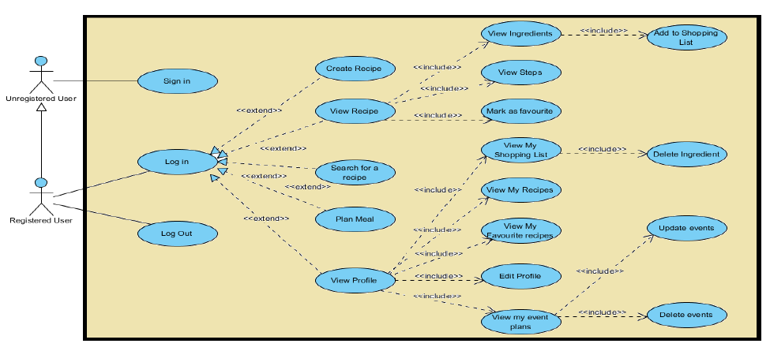
System Modeling (Use Case Diagram)
System Use Case Diagram

Slide 11
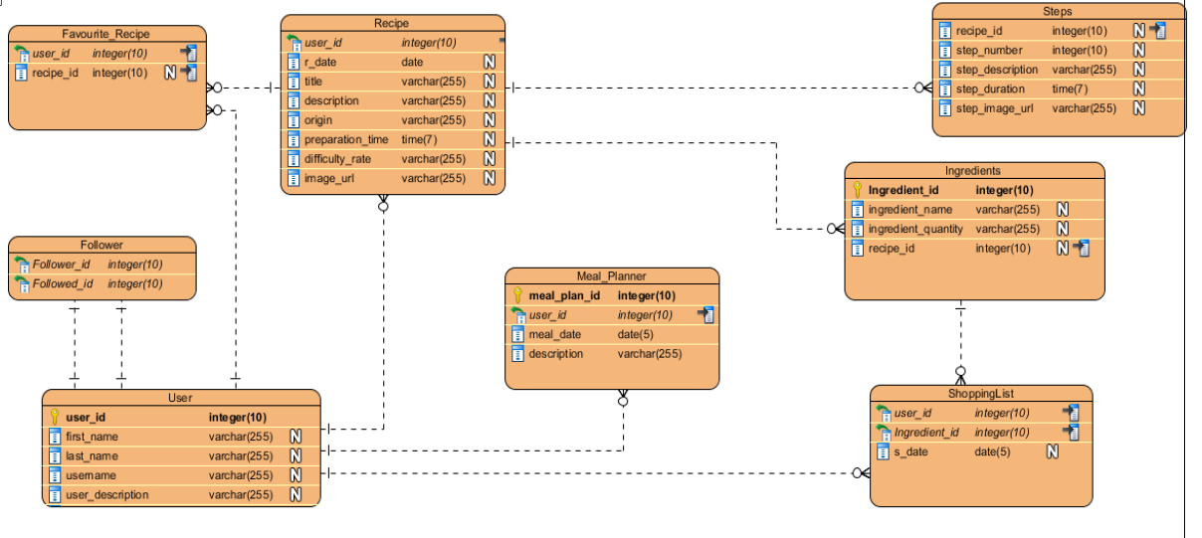
System Modeling (Class Diagram)
System Class Diagram

Slide 12
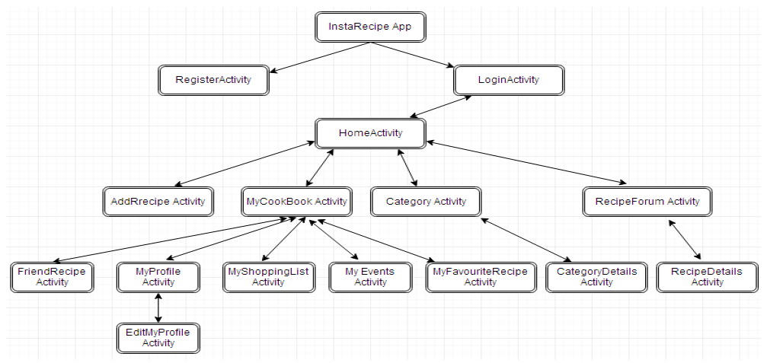
System Modeling (Activity Diagram)

Slide 13
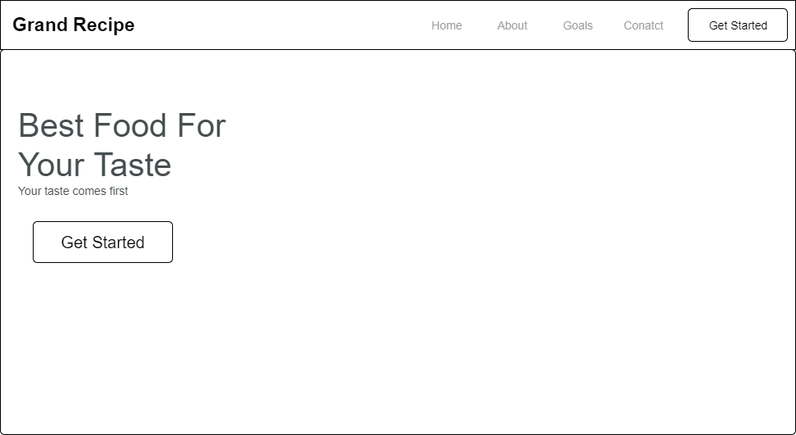
Proposed Interface Design
Homepage

Slide 14
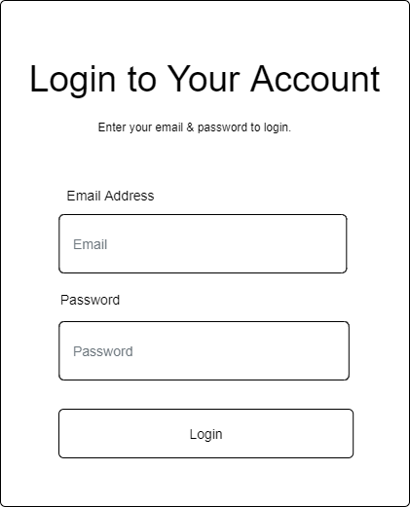
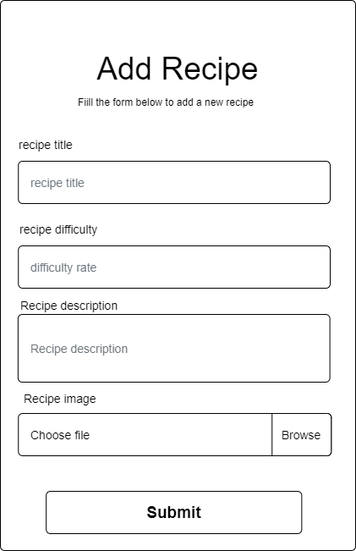
Proposed Interface Design
Add Recipe Form
Fig 3.5 Login Form

Slide 15

Summary
The area covered in this research work focuses on recipes not limited to a particular region in the world but based on recipes for certain dietary needs like for diabetes patients
Online Recipe Website

Slide 16


Thank you

